Slide 1

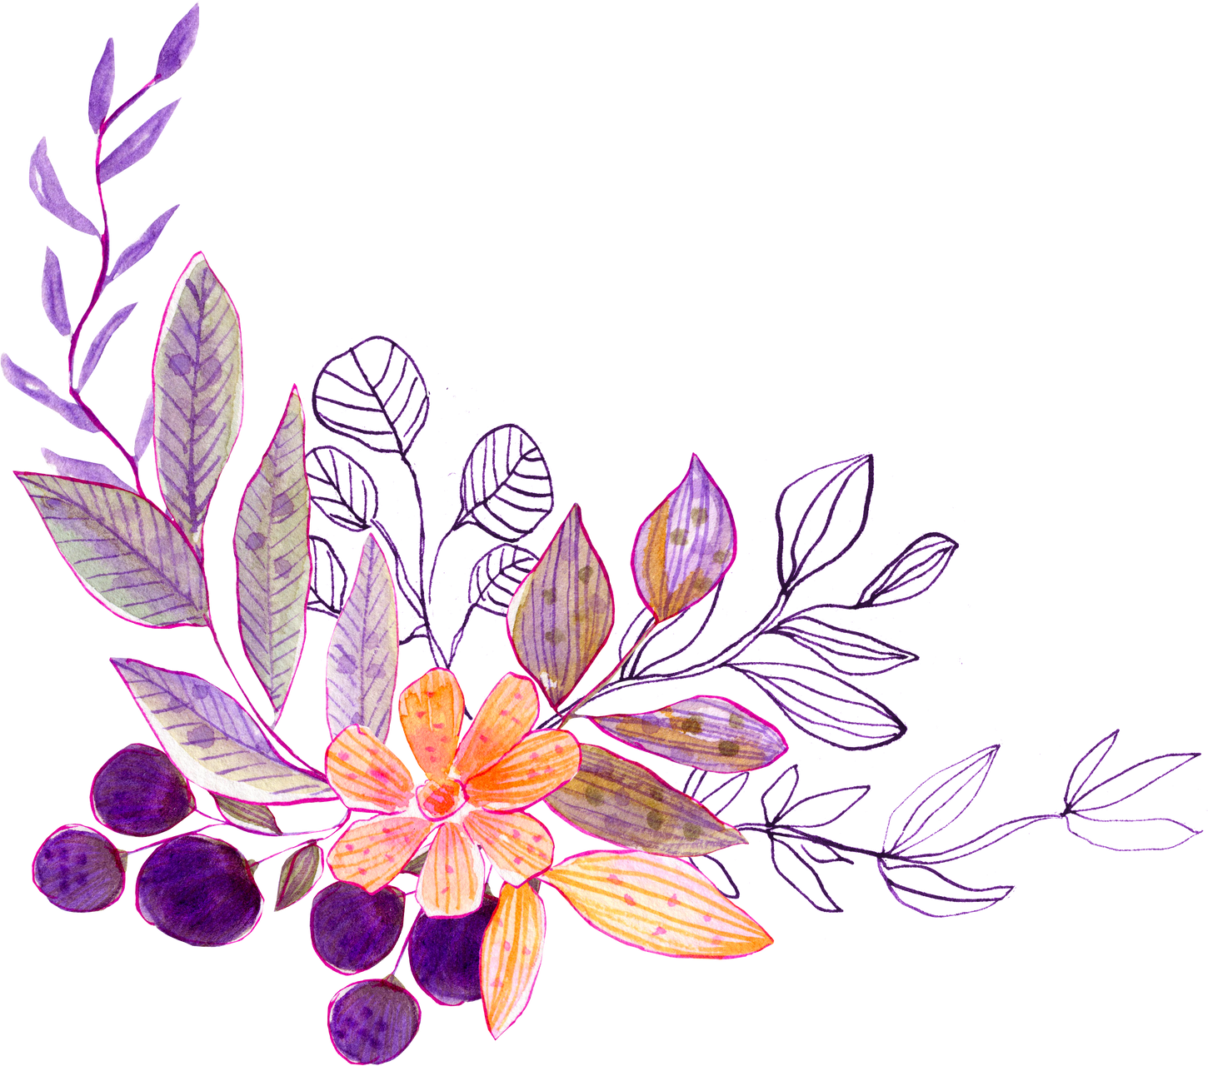

DIGITAL PORTFOLIO
STUDENT NAME:R.Bakkiyalakshmi
REGISTER NO AND NMIDD:2422k1247
asbru4k2422k1247
DEPARTMENT:B.Sc(Computer Science)
COLLEGE: COLLEGE/UNIVERSITY:
Maharani arts & Science College,
Bharathiyar University.

Slide 2
PROJECT TITLE
Digital Portfolio
Personal digital portfolio using HTML,CSS, and JAVA SCRIPTS.
Design and development of a web-based digital portfolio.

Slide 3
AGENDA
1.Problem Statement
2.Project Overview
3.End Users
4.Tools and Technologies
5.Portfolio design and Layout
6.Features and Functionality
7.Results and Screenshots
8.Conclusion
9.Github Link

Slide 4
PROBLEM STATEMENT
Many students face challenges in showcasing their skills, projects, and achievements in a structured way.With a proper platform, their talents often remain unnoticed.A personal portfolio website solves this problem by providing a digital space to present academic work, technical skills, and creative projects.Tish helps in building a professional identity and improving career or academic opportunities.

Slide 5
PROJECT OVERVIEW
The digital portfolio is a personalized website designed to highlight academic achievements, technical skills, and creative projects.It provides a well-organized platform to present personal details, educational background, and project work.The portfolio also includes interactive features like images,links, and a contact section.Overall,it serves as a digital resume that reflects both professionalism and individuality.

Slide 6
WHO ARE THE END USERS?
The end users of a digital portfolio include teachers and professors who assess academic growth.Recruiters and employer's use it to evaluate skills and projects for career opportunities.Peers and classmates may also view it for collaboration and inspiration.Additionally, mentors and institutions can use it to track overall development.

Slide 7
TOOLS AND TECHNOLOGIES
The digital portfolio is developed using HTML for Structure, CSS for styling, and JavaScript for interactivity.It may also include frameworks like Bootstrap or Tailwind CSS for responsive design.For hosting, platform such as GitHub Pages or Netlify can be used.Additionally, tools like Canva or Photoshop help in creating visuals and graphics

Slide 8
PORTFOLIO DESIGN AND LAYOUT
The digital portfolio is designed with a clean and simple layout for easy navigation.It includes sections like home, about, education, skills, projects, and contact.Visual elements such as images, icons, and colors make it attractive and engaging.The responsive design ensures it works well on both computers and mobile devices.

Slide 9
FEATURES AND FUNCTIONALITY
The digital portfolio highlights personal details, skills, and academic achievements in an organized way.It allows showcasing projects with descriptions, images, and links.A contact section enables easy communication with teachers,peers,or recruiters.The portfolio is interactive, user-friendly, and accessible on different devices.

Slide 10
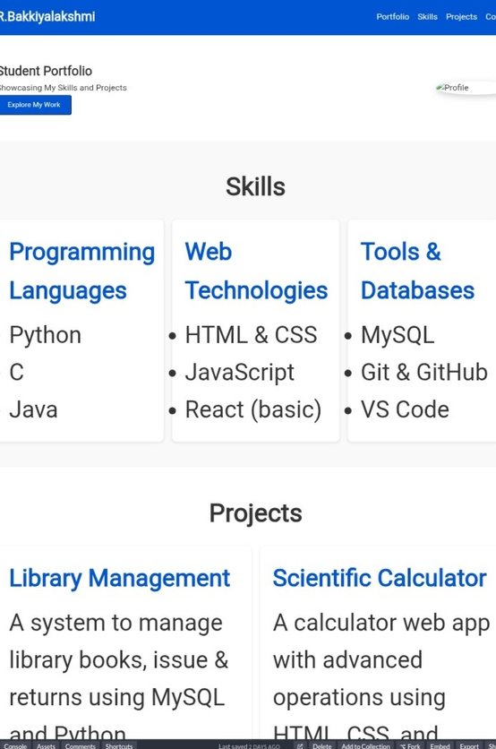
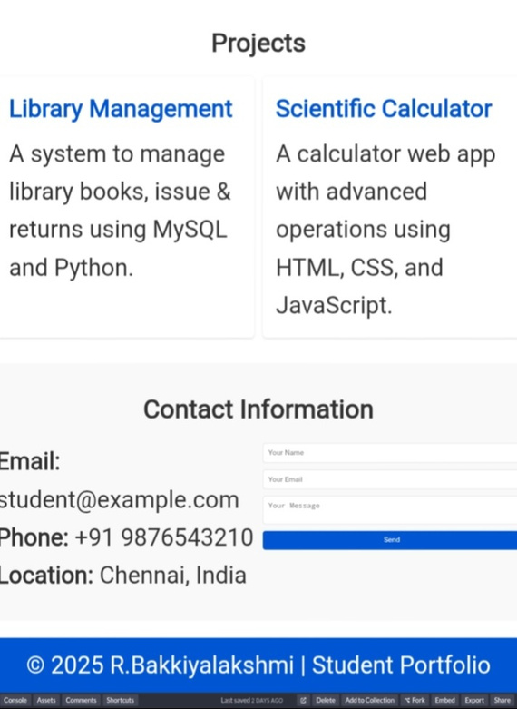
RESULTS AND SCREENSHOTS

Slide 11
CONCLUSION
The digital portfolio serves as a student portfolio to showcase academic achievements, skills, and projects.It helps in building a professional identity and creates a positive impression.The portfolio is easy to use, visually appealing, and accessible on multiple devices.Overall,it is an effective tool for both academic and career opportunities.

